Slide 1
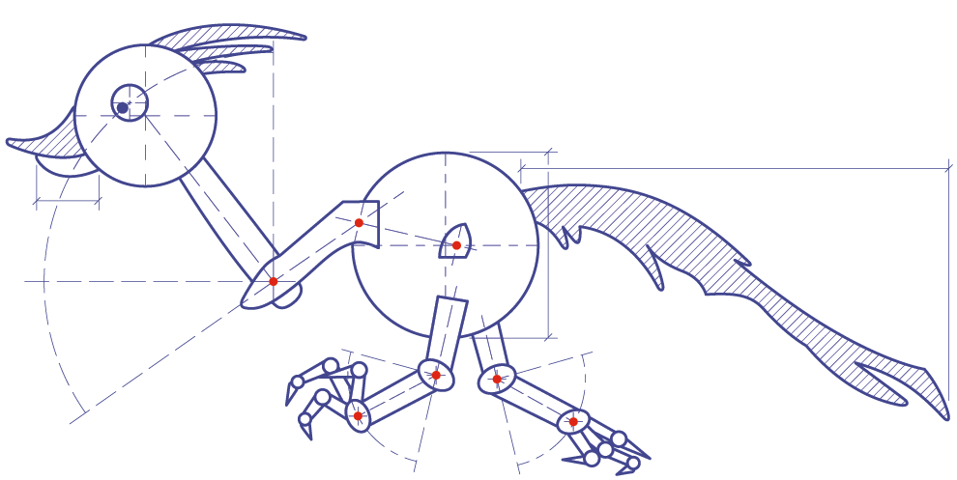
ChapR
The
TM
v2.0
Created by: Chap Research
Patent #9043031
power
action
on
connect
http://TheChapR.com

